Slide 1

OPERATING SYSTEM

Slide 2
SOLUTION TO CRITICAL SECTION PROBLEM
S
Software based solution (2 Process Solution)
Using Boolean variable turn
Using Boolean array flag [ ]
Peterson’s solution
Hardware based solutions
Disable interrupts
Atomic instructions: TestAndSet and Swap
OS solutions:
Semaphore

Slide 3
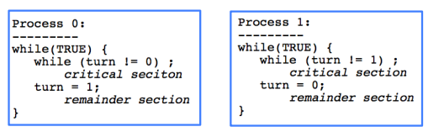
A SIMPLE SOLUTION
S
Bool turn;->indicate whose turn to enter CS
T0 and T1: alternate between CS and remainder
Pros:
1. Pi’s critical section is executed
iff turn = i
2. Pi is busy waiting if Pj is in CS
(mutual exclusion)
Cons:
Progress is not satisfied since it requires strict alternation
A process cannot enter the CS more often than the other.

Slide 4
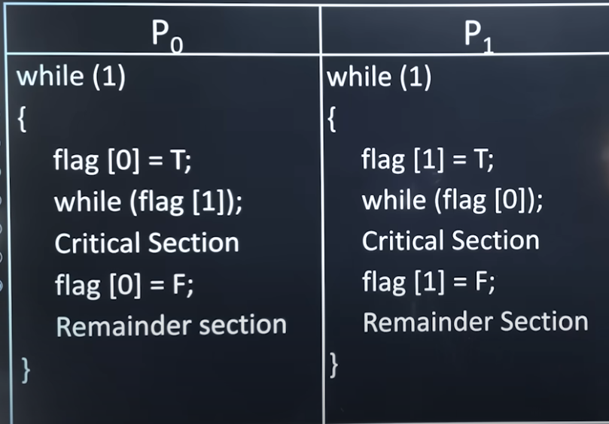
Using Boolean array flag [ ]: array will have two cells each cell is
initialized to F

Slide 5
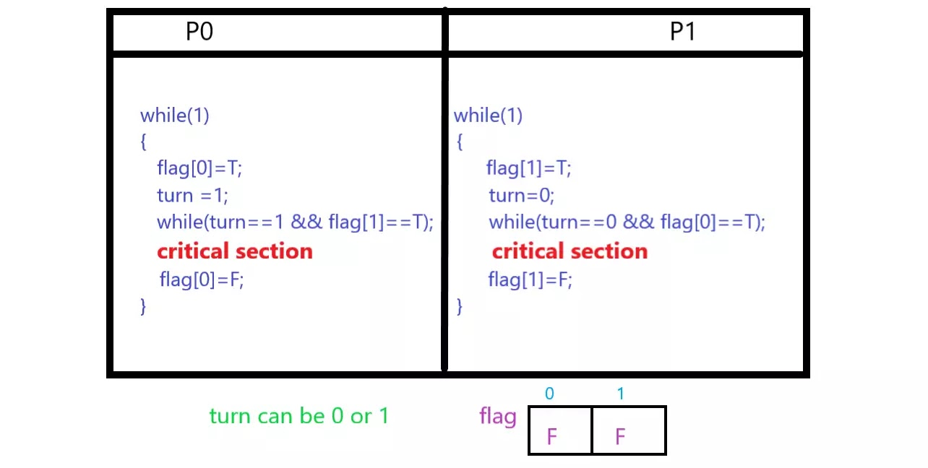
PETERSON SOLUTION:

Slide 6
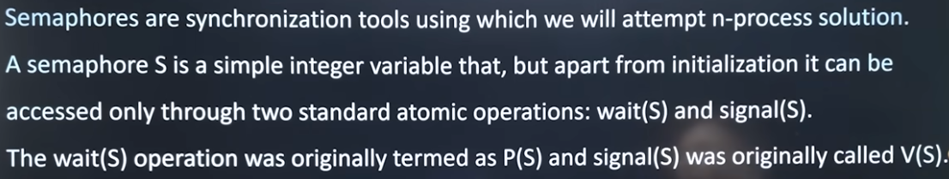
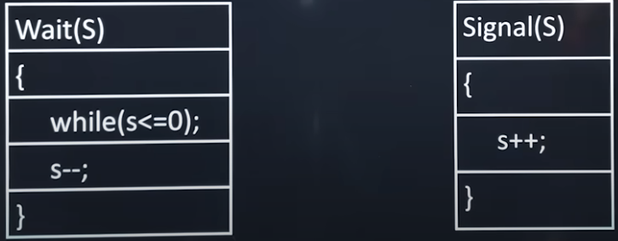
SEMAPHORES:

Slide 7
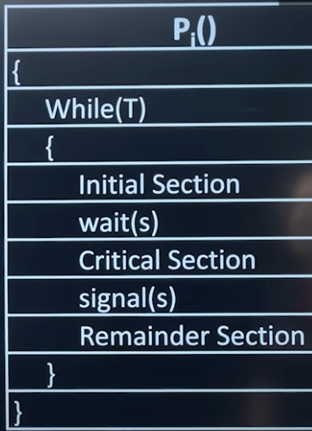
‘N’ PROCESS SYNCHRONIZATION SOLUTION USING SEMAPHORE:
Steps | Code / Section
Start Loop | While(T)
Initial Execution | Initial Section
Request for Resource | wait(s)
Critical Execution | Critical Section
Release Resource | signal(s)
Non-Critical Execution | Remainder Section

Slide 8
OUTLINE
Classical Synchronization Problems
Producer Consumer Problem / Bounded Buffer Problem
Dining Philosophers Problem (DPP)
Reader Writer Problem

Slide 9
PRODUCER-CONSUMER PROBLEM
The Producer-Consumer problem is a classical multi-process synchronization problem, that is we are trying to achieve synchronization between more than one process.
There is one Producer in the producer-consumer problem, the Producer is producing some items, whereas there is one Consumer that is consuming the items produced by the Producer. The same memory buffer is shared by both producers and consumers which is of fixed size.
The task of the Producer is to produce the item, put it into the memory buffer, and again start producing items. Whereas the task of the Consumer is to consume the item from the memory buffer.
Problem:
The producer should produce data only when the buffer is not full. In case it is found that the buffer is full, the producer is not allowed to store any data into the memory buffer.
Data can only be consumed by the consumer if and only if the memory buffer is not empty. In case it is found that the buffer is empty, the consumer is not allowed to use any data from the memory buffer.
Accessing memory buffer should not be allowed to producer and consumer at the same time.

Slide 10
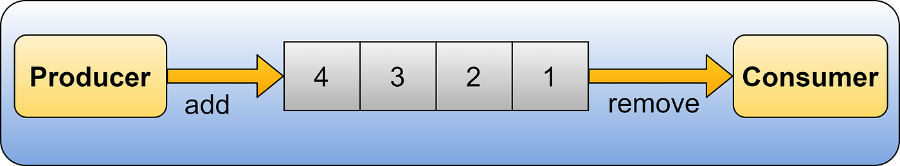
Solution:
Producer() | Consumer()
{ | {
while(T) | while(T)
{ | {
// Produce an item | wait(F); // UnderFlow
wait(E); // OverFlow | wait(S);
wait(S); | // Pick item from buffer
// Add item to buffer | Signal(S);
Signal(S); | Signal(E);
Signal(F); | Consume item
} | }
} | }
Semaphore S = 1
Semaphore E = n // Count empty cells
Semaphore F = 0 // Count filled cells

Slide 11
READERS-WRITERS PROBLEM
Problem relates to an object such as a file that is shared between multiple processes. Some of these processes are readers i.e., they only want to read the data from the object and some of the processes are writers i.e., they want to write into the object.
The readers-writers problem is used to manage synchronization so that there are no problems with the object data.
For example - If two readers access the object at the same time there is no problem. However, if two writers or a reader and writer access the object at the same time, there may be problems.

Slide 12
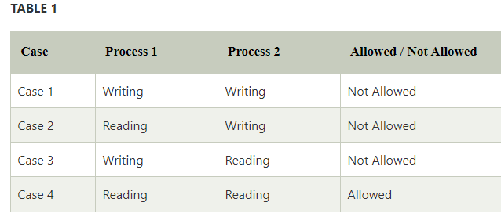
WHY READER WRITER PROBLEM?
Let's understand with an example - If two or more than two readers want to access the file at the same point in time there will be no problem. However, in other situations like when two writers or one reader and one writer wants to access the file at the same point of time, there may occur some problems, hence the task is to design the code in such a manner that if one reader is reading then no writer is allowed to update at the same point of time, similarly, if one writer is writing no reader is allowed to read the file at that point of time and if one writer is updating a file other writers should not be allowed to update the file at the same point of time. However, multiple readers can access the object at the same time.

Slide 13
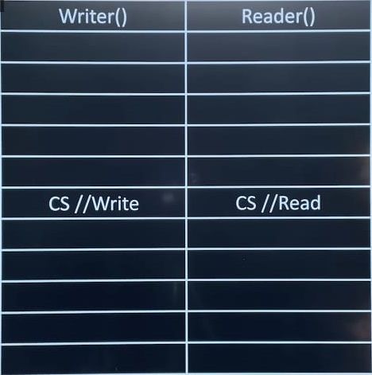
Mutex = 1
Wrt = 1
Readcount = 0 (Not a Semaphore)

Slide 14
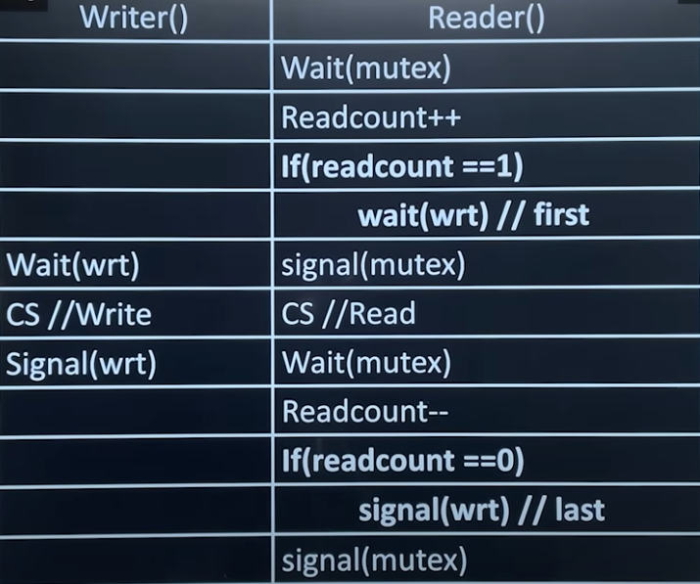
SOLUTION FOR READER WRITER PROBLEM?
The solution of readers and writers can be implemented using binary semaphores.
In the above code of reader, mutex and write are semaphores that have an initial value of 1, whereas the readcount variable has an initial value as 0. Both mutex and write are common in reader and writer process code, semaphore mutex ensures mutual exclusion and semaphore write handles the writing mechanism.

Slide 15

DINING PHILOSOPHERS PROBLEM (DPP)
The dining philosopher is a classic synchronization problem as it demonstrates a large class of concurrency control problems.
The dining philosophers problem states that there are 5 philosophers sharing a circular table and they eat and think alternatively. There is a bowl of rice for each of the philosophers and 5 chopsticks. A philosopher needs both their right and left chopsticks to eat.

Slide 16
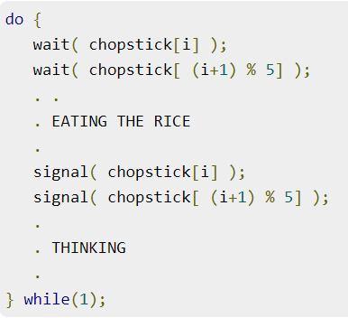
SOLUTION
A solution to the Dining Philosophers Problem is to use a semaphore to represent a chopstick. A chopstick can be picked up by executing a wait operation on the semaphore and released by executing a signal semaphore.

Slide 17
PROBLEM WITH THE SOLUTION
The above solution makes sure that no two neighboring philosophers can eat at the same time. But this solution can lead to a deadlock. This may happen if all the philosophers pick their left chopsticks simultaneously. Then none of them can eat and deadlock occurs.
Some of the ways to avoid deadlock are as follows −
There should be at most four philosophers on the table with 5 chopsticks.
An even philosopher should pick the right chopstick and then the left chopstick while an odd philosopher should pick the left chopstick and then the right chopstick.
A philosopher should only be allowed to pick their chopstick if both are available at the same time.

Slide 18

SLEEPING BARBER PROBLEM
Barbershop: A barbershop consists of a waiting room with n chairs and a barber room with one barber chair.
Customers: Customers arrive at random intervals. If there is an available chair in the waiting room, they sit and wait. If all chairs are taken, they leave.
Barber: The barber sleeps if there are no customers. If a customer arrives and the barber is asleep, they wake the barber up.
Synchronization: The challenge is to coordinate the interaction between the barber and the customers using concurrent programming mechanisms.

Slide 19
SOLUTION:
Barber (process) | Customer (process)
while(true) | wait(mutex);
{ | if(waiting < n) {
wait(customer); | waiting = waiting + 1;
wait(mutex); | signal(customer);
waiting = waiting - 1; | signal(mutex);
signal(barber); | wait(barber);
signal(mutex); | // haircut
// haircut | }
} | else {
 | signal(mutex);
 | }
S Barber = 0
S customer = 0 (Counting Sem)
S mutex = 1
Waiting = 0 (n No. of waiting Customer)

Slide 20
HARDWARE SOLUTIONS:
Disable Interrupt
Boolean test and set
Boolean test_and_set (Boolean *target)
{
Boolean rv = *target;
*target = true;
return rv;
}
While(1)
{
while (test and set(&lock));
/* critical section */
lock = false;
/* remainder section */
}

Slide 21
Thank You

